Slide 1
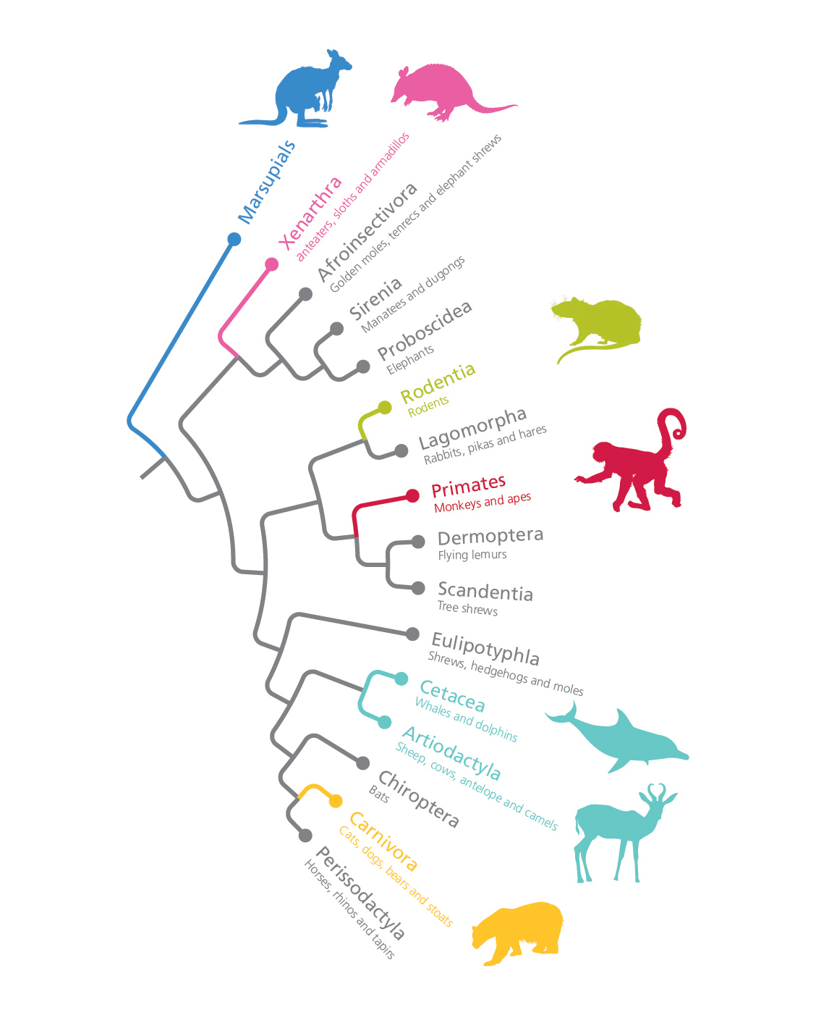
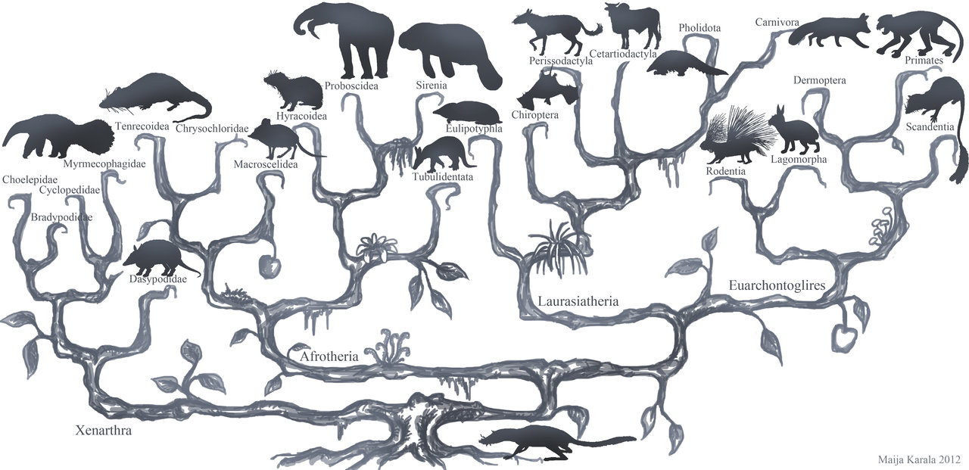
Phylogenetic Relationships of Placental Mammals
Name: Sau Qwan (Cavannah) Yap

Slide 2
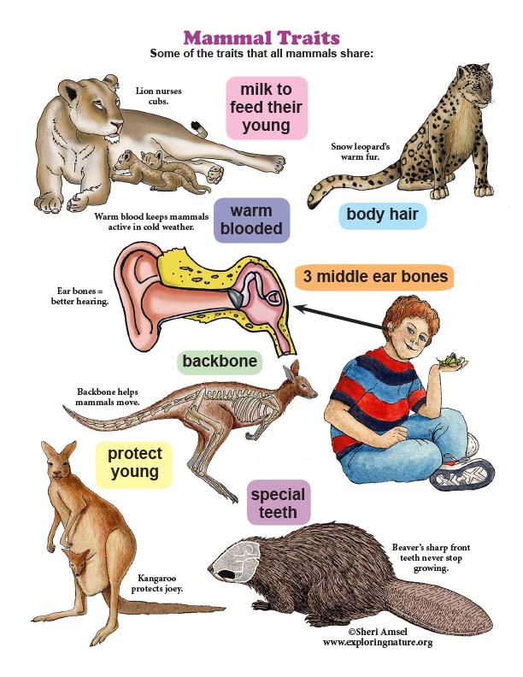
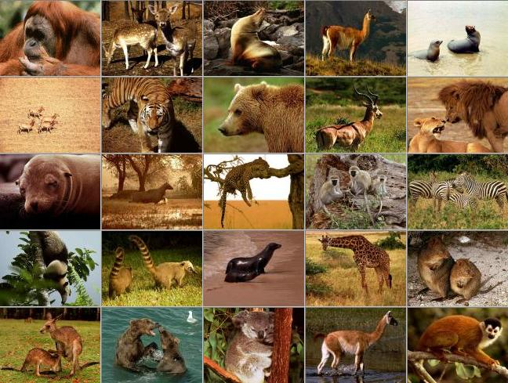
Introduction
Mammals are warm-blooded vertebrate animals which belong to the class Mammalia.
Female mammals possess milk producing mammary glands.
Mammals have neocortex in their brain, hair, and three middle ear bones.
Notes:
Female mammals possess milk producing mammary glands used for feeding their young, a neocortex region of the brain, fur or hair, and three middle ear bones. These characteristics distinguish them from reptiles and birds, from which their ancestors diverged a long time ago.

Slide 3
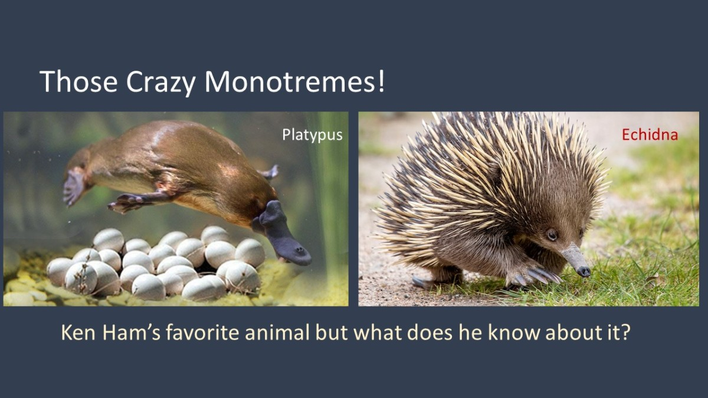
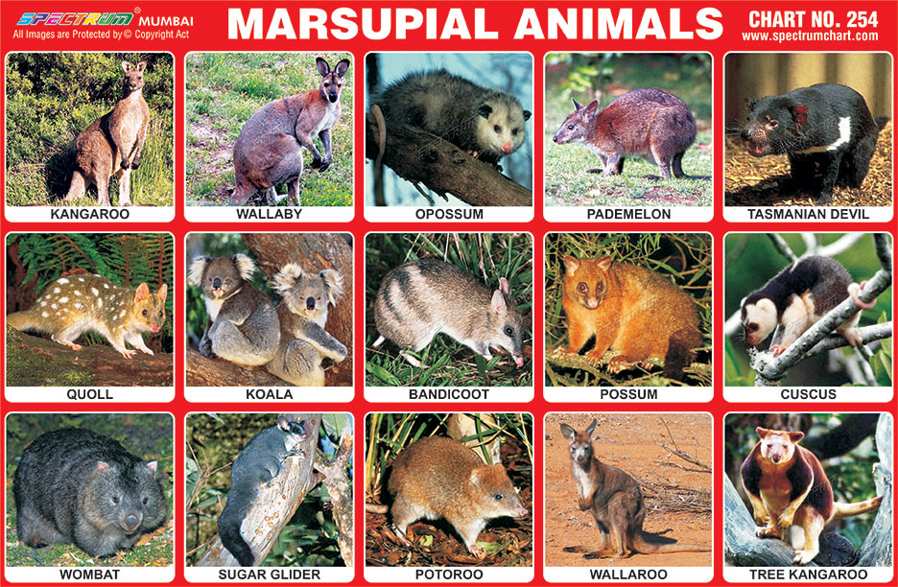
Three Subclasses of Mammals
Monotremes (Prototheria)
Rare egg-laying mammals
Marsupials (Metatheria)
Newborn offspring develops within an external pouch attached to the mother’s abdomen.
Five to seven extant orders
Placental Mammals (Eutheria)
Unborn offspring develops in placenta within the mother’s uterus
18 extant orders

Slide 4
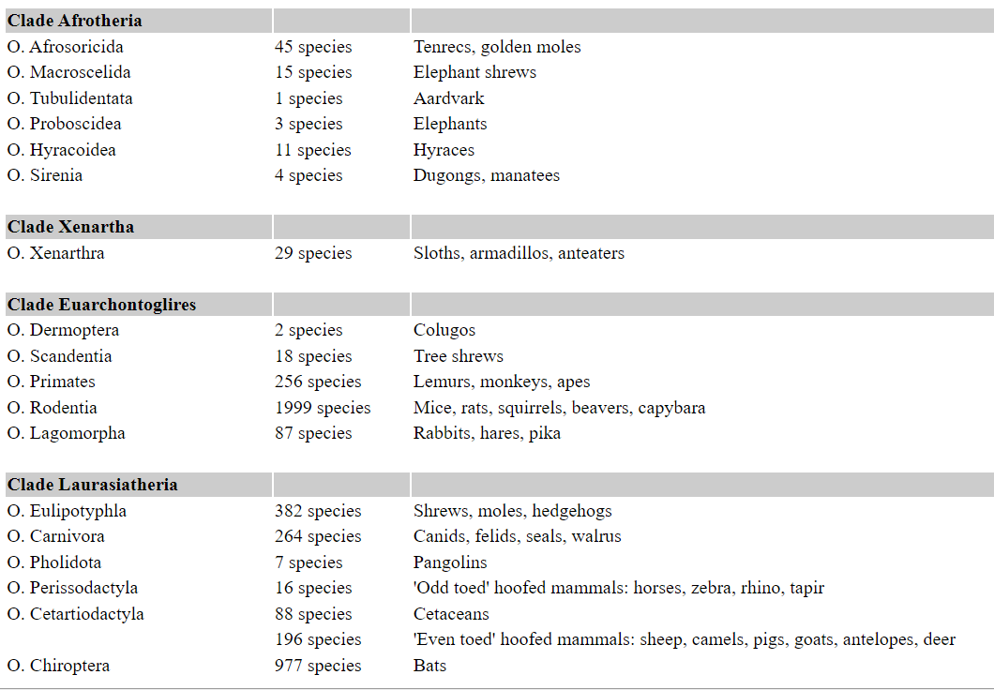
18 Orders of Placental Mammals
Notes:
The mammalian supertree classifies placental mammals phylogenetically using DNA sequence data to group together mammals that are evolutionarily closely related, sharing a recent common ancestor.
The supertree classification places placental mammals in four superorders. The four superorders and some of the mammals in them are:
Afrotheria—aardvarks, elephants, manatees.
Xenarthra—anteaters, sloths, armadillos.
Laurasiatheria—bats, whales, hoofed mammals, carnivores.
Euarchontoglires—primates, rabbits, rodents.

Slide 5
What Was Known About Placental Mammals Relationships?
DNA sequences have suggested the superorder groups Paenungulata (elephants, sea cows and hyraxes) and Cetartiodactyla (artiodactyls and whales).
Traditional clades such as Archonta (primates, tree shrews, flying lemurs and bats) have been rejected by statistical tests.
Afrotheria (paenungulates, aardvarks, elephant shrews, golden moles and tenrecs) has been suggested by mitochondrial ribosomal RNA and nuclear protein-coding genes data
Notes:
DNA sequences have suggested the superorder groups Paenungulata (elephants, sea cows and hyraxes) and Cetartiodactyla (artiodactyls and whales)
Traditional clades such as Archonta (primates, tree shrews, flying lemurs and bats) have been rejected by statistical tests on DNA sequence analysis
Afrotheria, which is a group that includes paenungulates, aardvarks, elephant shrews, golden moles and tenrecs, has been suggested by mitochondrial ribosomal RNA and nuclear protein-coding genes data

Slide 6
Research Questions
What is the phylogenetic relationships among placental mammals?
Were there parallel adaptive radiations among placental mammals?

Slide 7
Methods

Slide 8
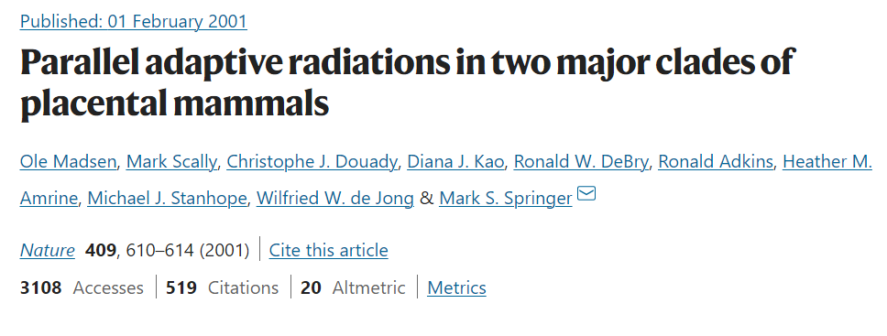
Data Collection
Two independent datasets were obtained from a paper.
One dataset (5708bp) consists of:
Concatenated DNA sequences for mitochondrial RNA genes and three nuclear genes (A2AB, IRBP, vWF)
All eutherian orders and two marsupial outgroups
Two insectivore families, Chrysochloridae (golden mole) and Tenrecidae (tenrec) for every gene except IRBP
The second dataset (BRCA1) consists of:
2947 bp aligned BRCA1 DNA sequences
All placental orders and one marsupial outgroup
Notes:
two independent datasets were obtained from a paper that investigated parallel adaptive radiations in placental mammals. Concatenations of individual genes can be employed to achieve high resolving power when trying to elucidate phylogenetic relationships. A dataset that consists of concatenated DNA sequences for mitochondrial RNA genes and three nuclear genes (A2AB, IRBP, vWF) for 26 placental taxa was employed for phylogenetic analysis in this study. This dataset includes all eutherian orders and two marsupial outgroups. In addition, this dataset represents two insectivore families, Chrysochloridae (golden mole) and Tenrecidae (tenrec) for every gene except IRBP, which was necessary to elucidate the phylogenetic relationship of the insectivores and Afrotheria.
An independent data set from 3 kilobases (kb) of exon 11 of (BRCA1) for 33 taxa was used for hypothesis testing. The BRCA1 data set contains all placental orders and one marsupial outgroup.

Slide 9
Phylogenetic Analysis
Maximum parsimony and bootstrap analysis using heuristic search in PAUP.
Distance analysis using Jukes-Cantor and Kimura models in PHYLIP.
Minimum evolution analysis.
Maximum likelihood and bootstrap analysis using GTR+G model in RAxML-NG.
MCMC analysis using GTR + Γ model in MrBayes.
Notes:
Maximum parsimony and bootstrap analysis using heuristic search were conducted in PAUP for both datasets. The heuristic search was conducted using a random stepwise addition sequence with TBR branch swapping for 10 replicates. Bootstrap support values are based on 200 replications.
Distance analysis for both datasets was conducted using PHYLIP. Jukes-Cantor and Kimura models of sequence evolution were used to calculate distances from both DNA sequence data. Neighbor joining trees were created using the two distance matrices and a consensus tree was created to infer if different matrices result in different trees. Minimum evolution analysis was carried out for both distance matrices. Maximum likelihood and bootstrap analysis were carried out for both datasets using the GTR+G model of sequence evolution in RAxML-NG.
MCMC analysis was carried out for the 5708bp dataset. Since the dataset used for MCMC analysis with MrBayes contains four distinct gene regions (mitochondrial RNA genes, A2AB, IRBP, vWF), the analysis was run by specifying the data partitions corresponding to these four gene regions and defining a substitution model for each data partition in order to understand if the substitution process differs between these different gene regions. The analysis was run by assuming that all four gene regions evolved under the evolved under the GTR+Γ model and setting the prior for the rates heterogeneity to an exponential distribution with a rate parameter, λ = 0.05.

Slide 10
Results

Slide 11
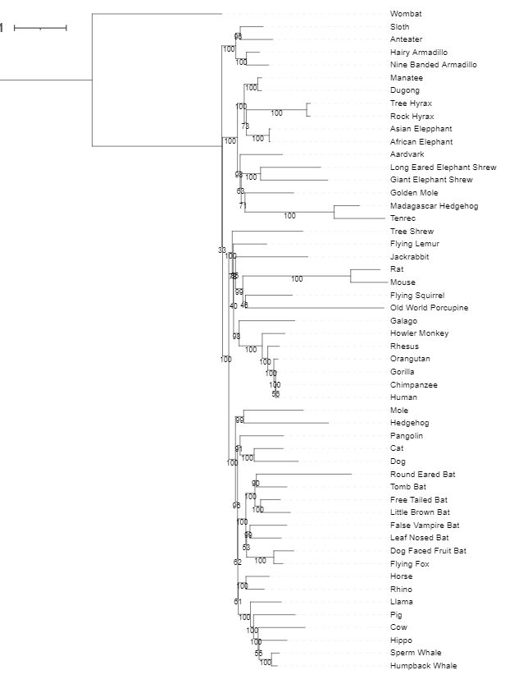
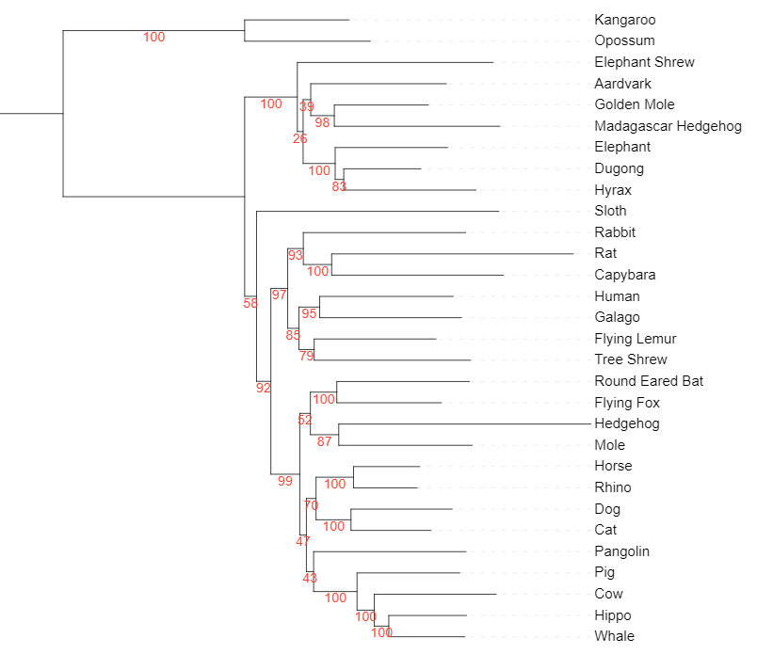
Placental orders are made up of Xenarthra, Afrotheria, Laurasiatheria, and Glires + Euarchonta
Xenarthra
Afrotheria
Afrotheria
Xenarthra
Glires + Euarchonta
Glires + Euarchonta
Laurasiatheria
Laurasiatheria
Best maximum likelihood tree for 5708bp dataset with Felsenstein bootstrap support values
Best maximum likelihood tree with Felsenstein bootstrap support values for BRCA1 dataset
Notes:
Xenarthra, Afrotheria, Laurasiatheria (shrews, hedgehogs, pangolins, bats, whales), and Glires (rodents and lagomorphs) + Euarchonta (flying lemurs, tree shrews and primates)

Slide 12
9-bp deletion at positions 353–383 of the BRCA1 dataset that presents in all 12 afrotherians
Notes:
Based on the BRCA1 DNA sequence data, Afrotheria is further supported by a 9-bp deletion that is present in all 12 afrotherians but not in the other placental mammals and marsupials that were investigated. This suggests that the 9-bp deletion could be due to shared common ancestry of Afrotheria.

Slide 13
There is robust support for Paenungulata in the Afrotheria clade
Xenarthra
Afrotheria
Afrotheria
Xenarthra
Glires + Euarchonta
Glires + Euarchonta
Laurasiatheria
Laurasiatheria
Best maximum likelihood tree for 5708bp dataset with Felsenstein bootstrap support values
Best maximum likelihood tree with Felsenstein bootstrap support values for BRCA1 dataset
Notes:
Based on likelihood analysis for both dataset

Slide 14
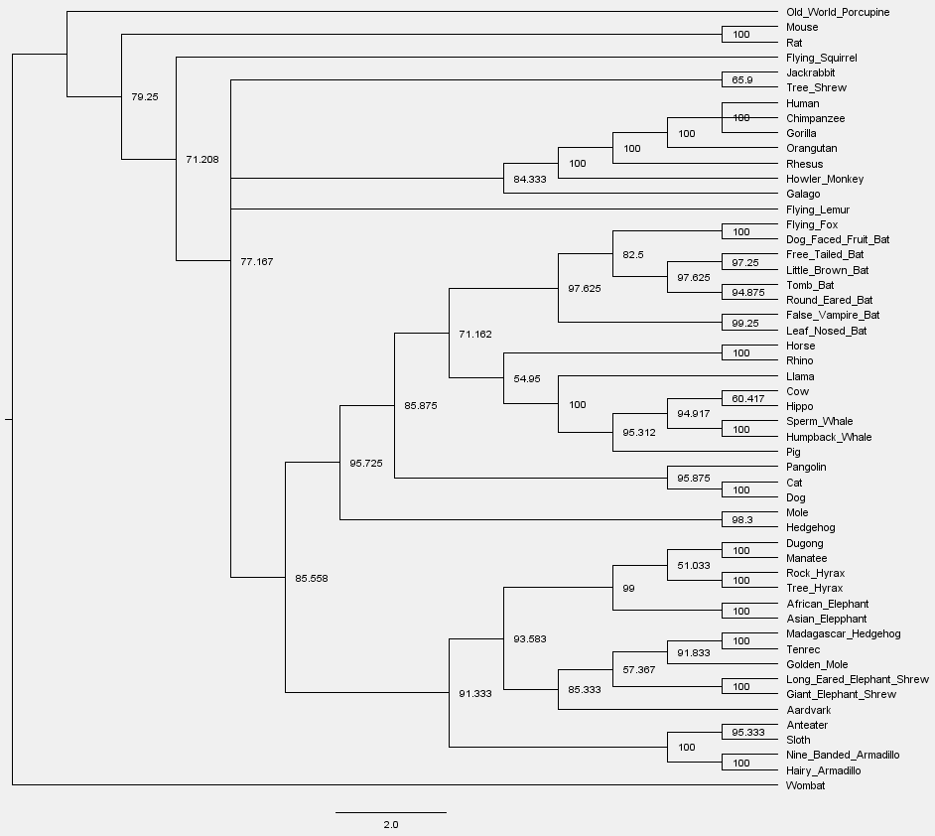
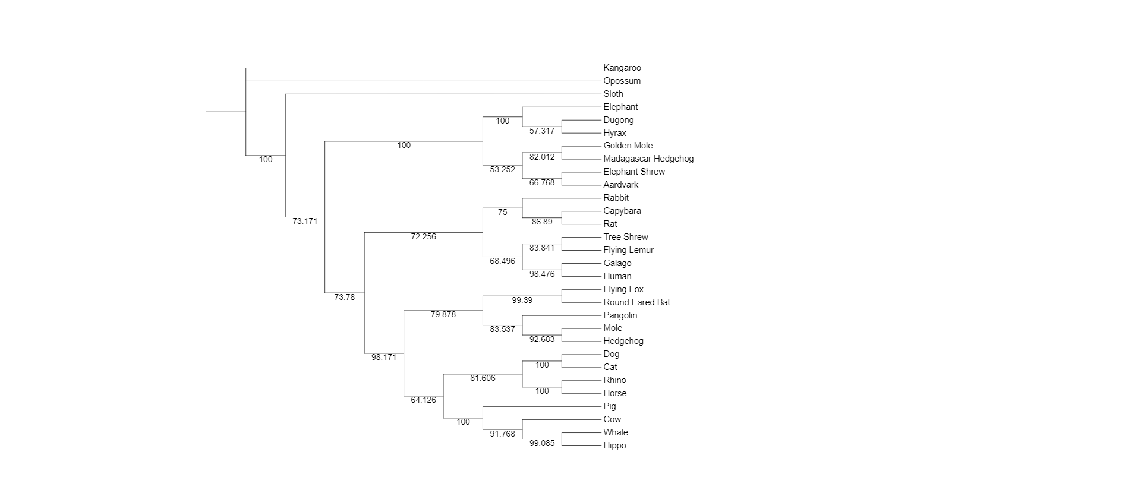
There is robust support for Paenungulata in the Afrotheria clade
Afrotheria
50% majority-rule consensus tree of 200 bootstrap trees for maximum parsimony analysis on 5708bp dataset.
50% majority-rule consensus tree of 200 bootstrap trees for maximum parsimony analysis on BRCA1 dataset
Notes:
Based on maximum parsimony analysis on both dataset

Slide 15
Afrotheria also includes golden moles (71%) and tenrecs (100%)
Xenarthra
Afrotheria
Afrotheria
Xenarthra
Glires + Euarchonta
Glires + Euarchonta
Laurasiatheria
Laurasiatheria
Best maximum likelihood tree for 5708bp dataset with Felsenstein bootstrap support values
Best maximum likelihood tree with Felsenstein bootstrap support values for BRCA1 dataset
Notes:
Afrotheria also includes golden moles and tenrecs, with 71% bootstrap support value for golden mole and 100% bootstrap support value for tenrec using maximum likelihood analysis, which are not represented in the likelihood analysis for 5708bp because they were not represented in the IRBP gene

Slide 16
Maximum parsimony analysis resulted in 91.8% support for golden mole and 100% support for tenrec
Glires + Euarchonta
Laurasiatheria
Afrotheria
Xenarthra
50% majority-rule consensus tree of 200 bootstrap trees for maximum parsimony analysis on BRCA1 dataset

Slide 17
There was inconsistent support for Euarchonta + Glires
50% majority-rule consensus tree of 200 bootstrap trees for maximum parsimony analysis on BRCA1 dataset
Best maximum likelihood tree with Felsenstein bootstrap support values for BRCA1 dataset
Notes:
Glires (rodents and lagomorphs) + Euarchonta (flying lemurs, tree shrews and primates). Cetartiodactyla (artiodactyls and whales).
There was inconsistent support for Euarchonta + Glires because the position of the root was not consistent across the different phylogenetic methods that were used to analyze the data. Maximum-likelihood analysis with the BRCA1 data set resulted in 100% bootstrap support for Glires + Euarchonta, whereas maximum parsimony analysis resulted in 79% support. parsimony tree for BRCA1 root on Old World porcupine, resulting in Euarchonta + Glires, Glires and Rodentia being paraphyletic.

Slide 18
There was inconsistent support for Euarchonta + Glires
Best maximum likelihood tree for 5708bp dataset with Felsenstein bootstrap support values
50% majority-rule consensus tree of 200 bootstrap trees for maximum parsimony analysis on 5708bp dataset.
Notes:
Glires (rodents and lagomorphs) + Euarchonta (flying lemurs, tree shrews and primates).
Parsimony bootstrap support value for Glires + Euarchonta was 72%, whereas maximum likelihood bootstrap support value was 97%

Slide 19
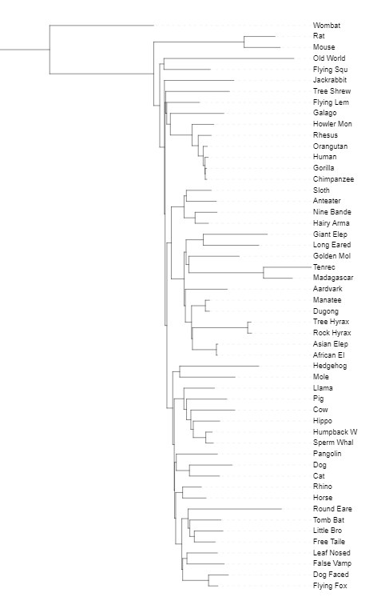
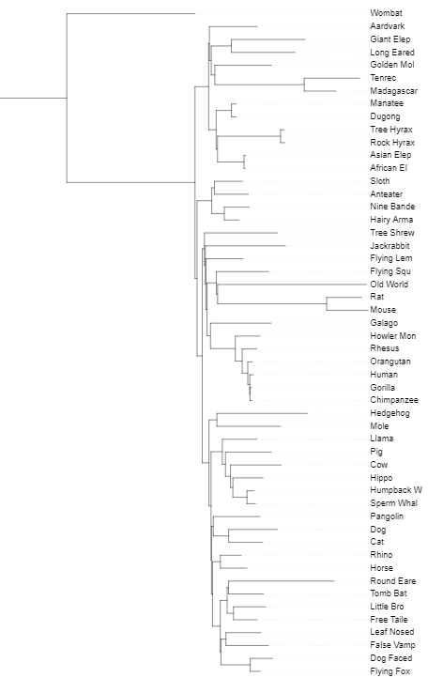
Distance analysis using Kimura and Jukes Cantor models showed differences in the rooting for Euarchonta + Glires
Neighbor joining trees using Kimura (left) and Jukes Cantor (right) models for BRCA1 dataset
Notes:
Neighbor joining tree with Jukes Cantor model of sequence evolution roots on rat and mouse, resulting in glires and rodentia being paraphyletic again

Slide 20
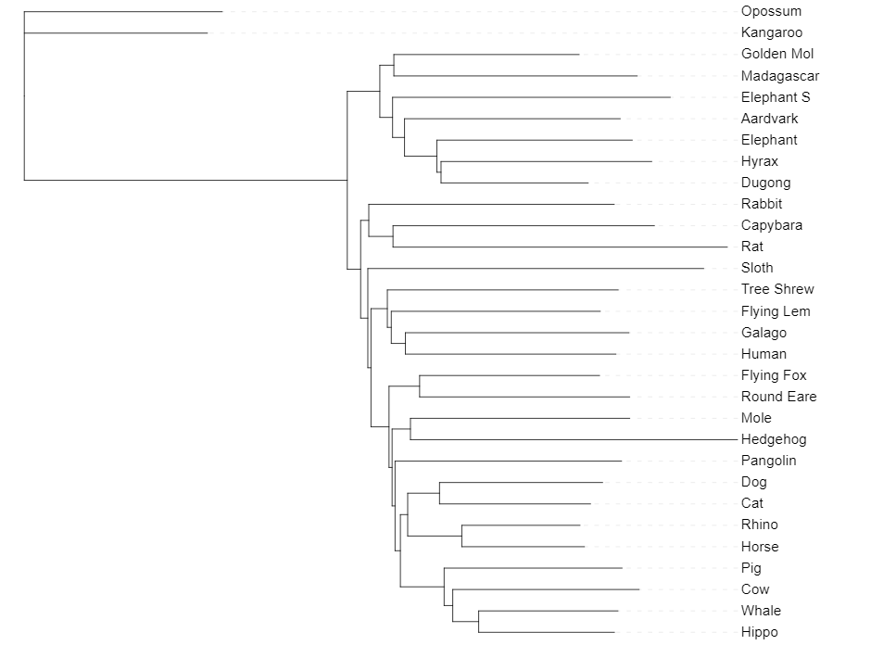
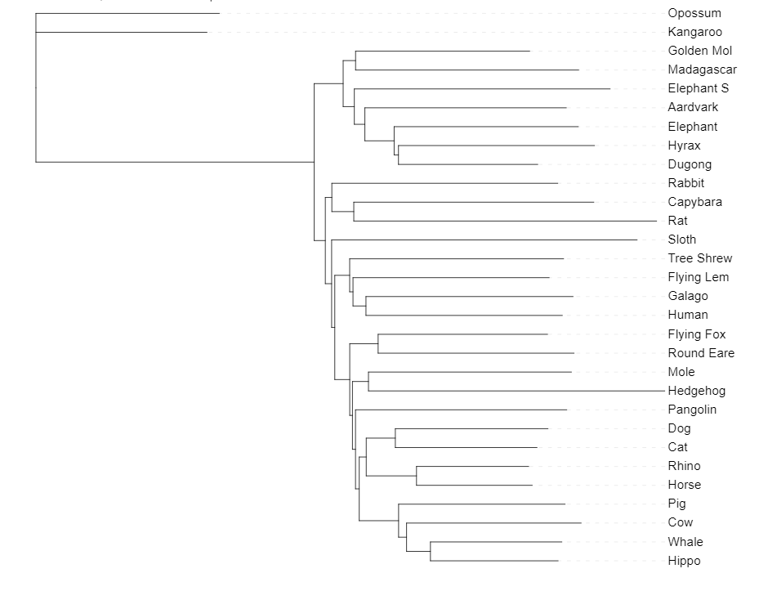
Distance analysis did not group Glires and Euarchonta together
Neighbor joining tree for 5708bp dataset using Kimura model
Neighbor joining tree for 5708bp dataset using Jukes Cantor model
Notes:
Distance analysis neighbor joining trees using Kimura and Jukes Cantor models for the 5708bp dataset did not group Glires and Euarchonta together.

Slide 21
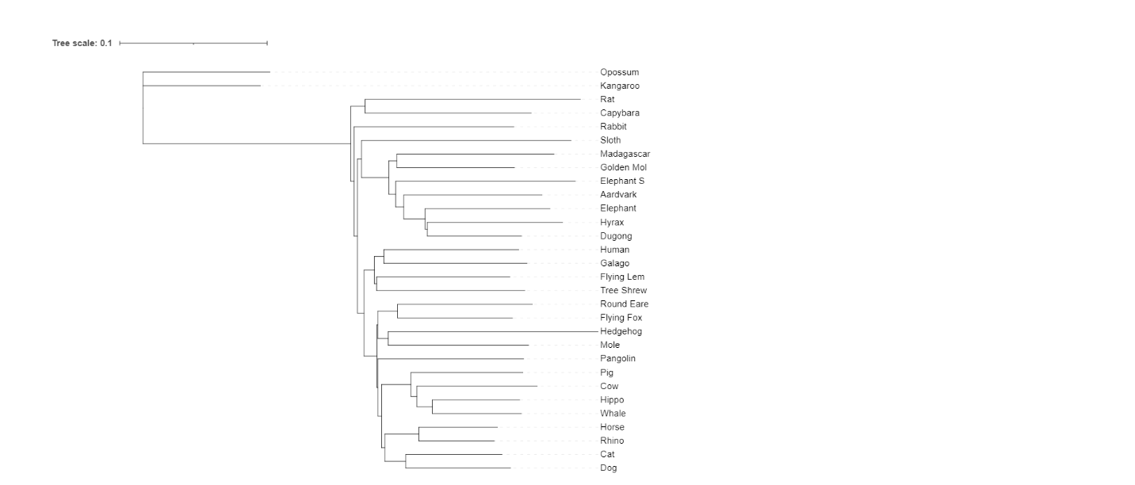
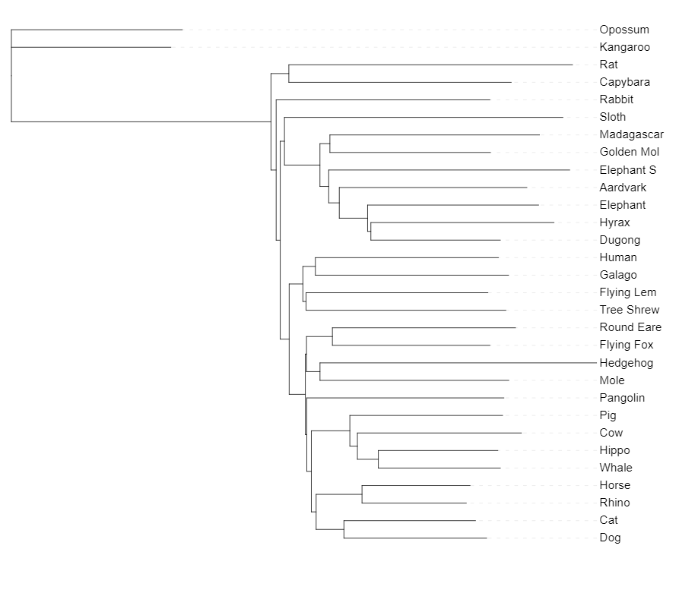
Minimum evolution analysis also did not group Glires and Euarchonta together
Minimum evolution tree for 5708bp dataset using Kimura model
Minimum evolution tree for 5708bp dataset using Jukes Cantor model
Notes:
Minimum evolution analysis also did not group Glires and Euarchonta together. Rabbit was not grouped with Rat and Capybara, rendering Glires being paraphyletic.

Slide 22
Summary
Placental orders are resolved into four groups: Xenarthra, Afrotheria, Laurasiatheria, and Euarchonta plus Glires.
These phylogenetic analysis results support hypotheses such as Paenungulata, Afrotheria and Laurasiatheria.
The results also provide support for parallel adaptive radiations in the placental clades Afrotheria and Laurasiatheria.
Afrotheria and Laurasiatheria both contain aquatic, ungulate and insectivore-like forms.
Notes:
Placental orders are resolved into four groups: Xenarthra, Afrotheria, Laurasiatheria, and Euarchonta plus Glires. The first three groups are consistently monophyletic with different methods of analysis. Euarchonta plus Glires is monophyletic or paraphyletic depending on the phylogenetic method. These phylogenetic analysis results support hypotheses such as Paenungulata, Afrotheria and Laurasiatheria. A unique nine-base-pair deletion in exon 11 of the BRCA1 gene provides additional support for the monophyly of Afrotheria. It had been suggested that there were parallel adaptive radiations in placental and marsupial mammals, leading to robust examples of convergence. Ungulate-like forms include perissodactyls and artiodactyls in Laurasiatheria and hyracoids in Afrotheria.

Slide 23
Thank you!
Questions?

